Slide 1
Computer Science Women’s Network presents
GHC 2010:
Why you should go
& how to get there

Slide 2
What’s GHC?

Slide 3
Grace Hopper Celebration of Women in Computing
“
The Grace Hopper Celebration of Women in Computing is a series of conferences designed to bring the research and career interests of women in computing to the forefront. Presenters are leaders in their respective fields, representing industrial, academic and government communities. Leading researchers present their current work, while special sessions focus on the role of women in today's technology fields, including computer science, information technology, research and engineering.
”
Grace Hopper Conference website: http://gracehopper.org

Slide 4
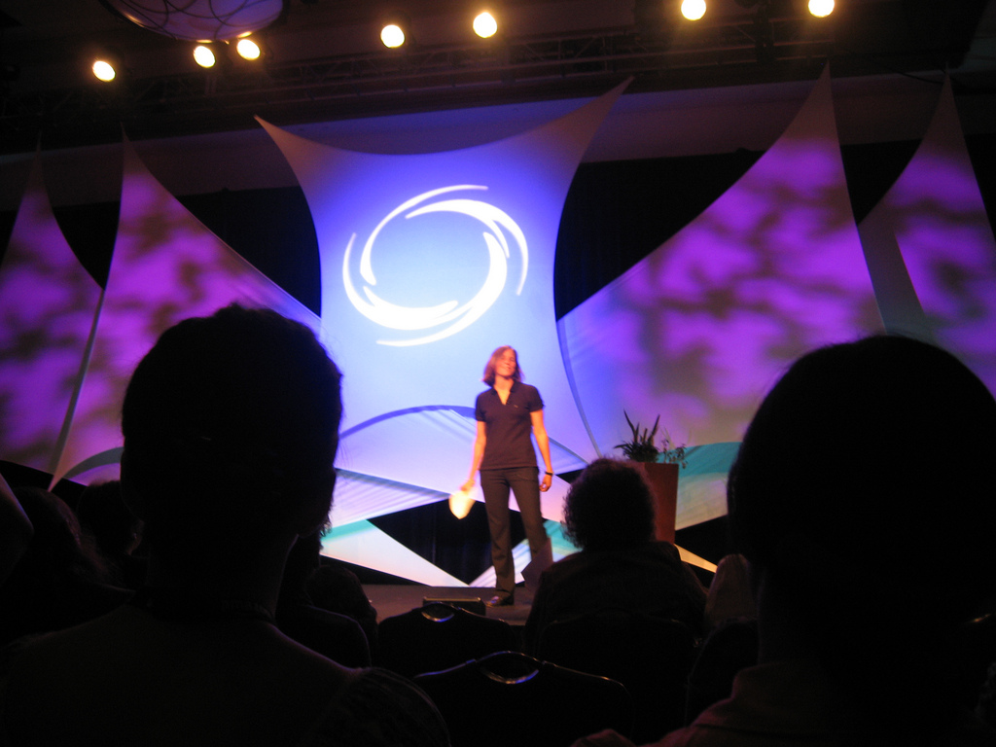

Slide 5
Who is Grace Hopper?

Slide 6
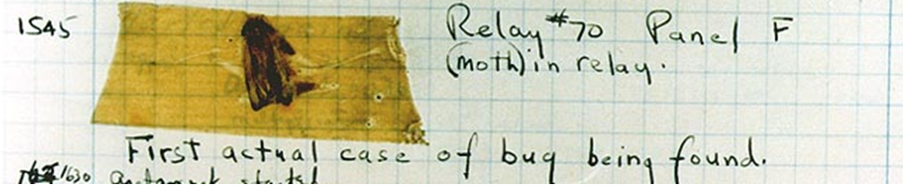
Rear Admiral Grace Murray Hopper
Credited with popularizing the term “debugging”
Wikipedia

Slide 7

Helped develop UNIVAC I
Developed the first compiler
Interest: transition from English to machine instructions
Contributed to COBOL
“Grandma COBOL”
Wikipedia, GHC website

Slide 8

GHC 2010
Atlanta, GA
September 28 – October 2
(Wednesday to Saturday)
Theme: “Collaborating Across Boundaries”

Slide 9
Why should I go?

Slide 10
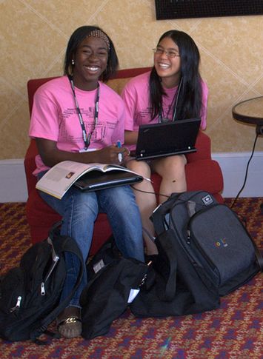
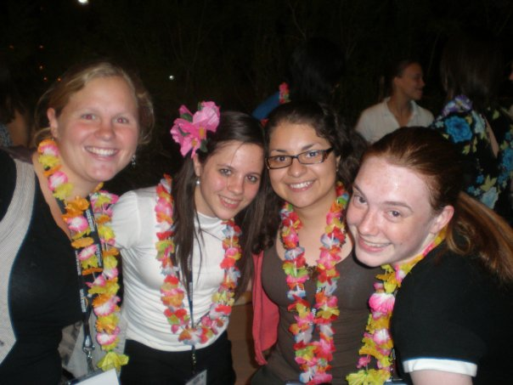
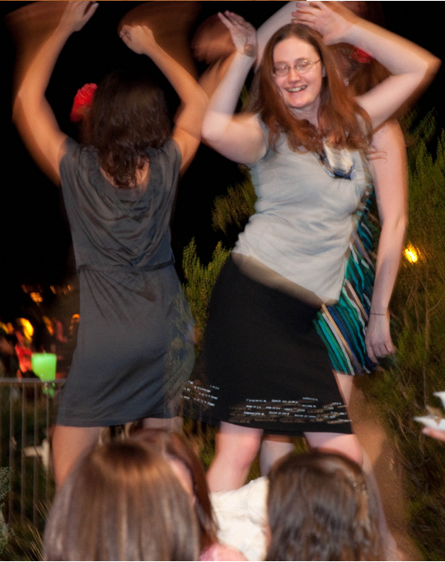
Credits: Flickr GHC 2009 group, Mariana Sada, Emily Raymond

Slide 11
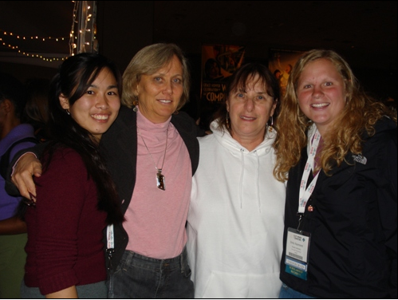
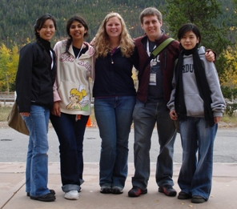
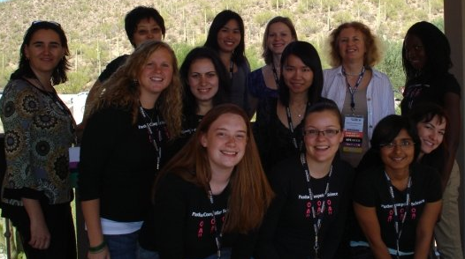
Credits: Titapha Tiet, Emily Raymond

Slide 12

Networking
Researchers?
Companies?
Grad schools?
They’re all there.
CONNECT project

Slide 13
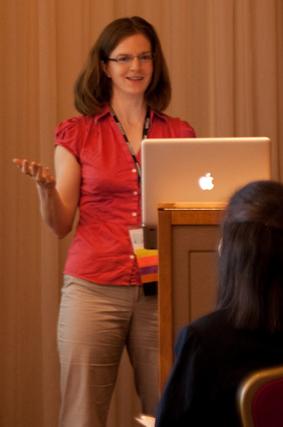
Research: New Investigators
New researchers share what they’ve been working on
Papers published in proceedings

Slide 14
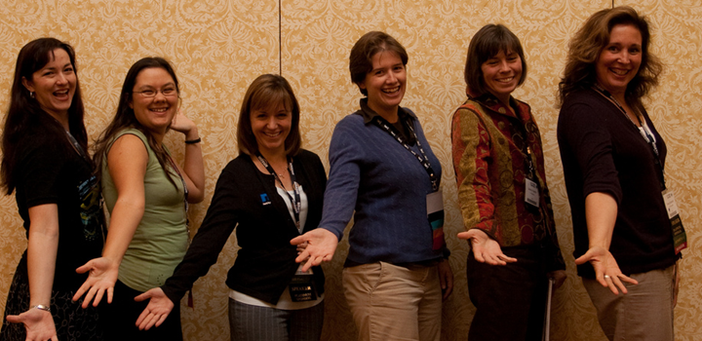
Research: Panels
Leaders in industry & academia lead discussions
Open Source Communities panel (far left: alumna Valerie Fenwick)

Slide 15
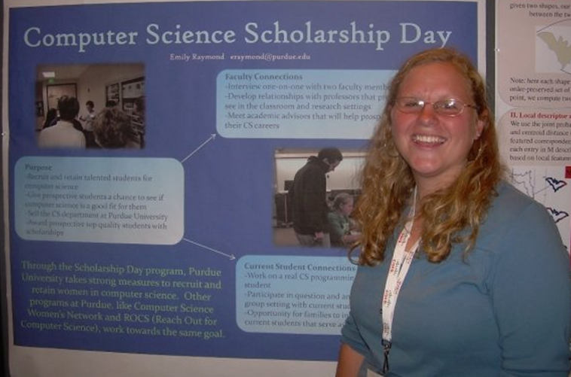
Research: Poster Session
Student researchers present

Slide 16
Learning
Tracks
Academia: “Becoming an Academic Leader”
Industry: “How We Did It: Breaking Through the Glass Ceiling”
Tech: research presentations, open source forum, cloud & distributed systems, etc.
Student: “Mastering the Art of the Technical Interview”
More: check out pages 158- 173, 277-279 of the 2009 Proceedings

Slide 17
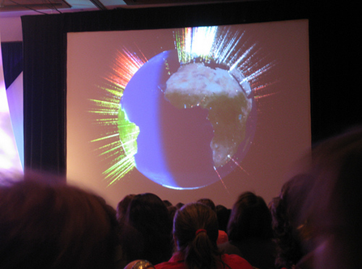
Involvement
Birds of a Feather sessions
Informal discussions/networking to solve problems
Presentations on projects in:
reform
social impact
education
development
empowerment
… all using CS

Slide 18
How do I get there?

Slide 19
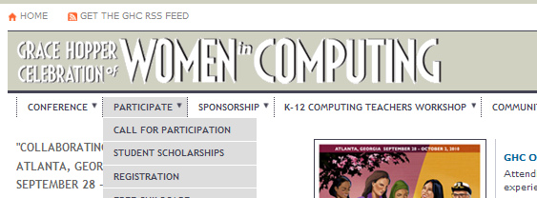
Apply for a GHC scholarship

Slide 20
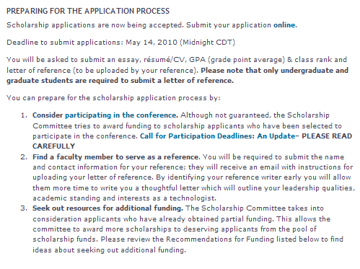
Stay tuned

Slide 21
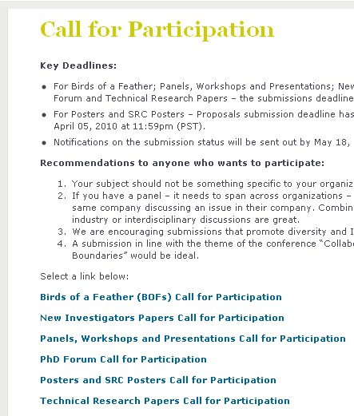
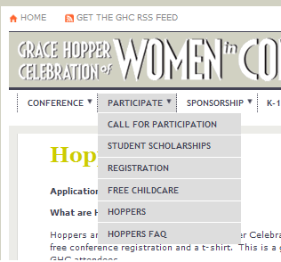
You can still submit a poster proposal
Deadline: April 5th
Summary (100 words)
Abstract (up to 2 pages) – checklist on Posters/SRC Call for Participation page

Slide 22
You can apply to be a Hopper (conference helper)
Free registration for working 2 4-hour shifts
Must still secure funds for travel, etc.
Applications open in July

Slide 23
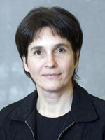
Email Renate Mallus
(mallus@purdue.edu)
To increase the chances of receiving travel funds from the CS Department, a student should apply for a GH scholarship, submit a poster or have submitted something else, or apply to be a Hopper.

Slide 24
Important Dates
April 5th – poster proposal deadline
May 14th – scholarship deadline
June 1st – registration opens
July 6th – Super Early Bird registration deadline
Sept. 9th – Early Bird registration deadline
Sept. 24th – final registration deadline
Sept. 29th – start of conference

Slide 25
Sources
GHC 2010 site:
http://gracehopper.org
Grace Hopper:
http://en.wikipedia.org/wiki/Grace_Hopper
http://gracehopper.org/2010/about/about-grace-hopper/
GHC 2009 Flickr group:
http://www.flickr.com/groups/ghc2009/pool/

